Slide 1




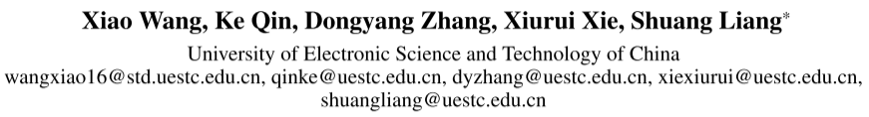





ATAI
Advanced Technique of Artificial Intelligence
ATAI
ChongqingUniversity _{AdvancedTechniqueof}
of Technology Artificial Intelligence
Chongqing University of
Technology
Chongqing University ^{ATAI}
_{of Technology} Advanced Techniqueof
Artificial Intelligence
Chongqing University of Technology
Chongqing University of Technology
Bid Farewell to Seesaw: Towards Accurate Long-tail Session-based
Recommendation via Dual Constraints of Hybrid Intents
Code: https://github.com/jarviswww/Code4HID
—— AAAI_2026
Reported by Can Wang
1

Slide 2
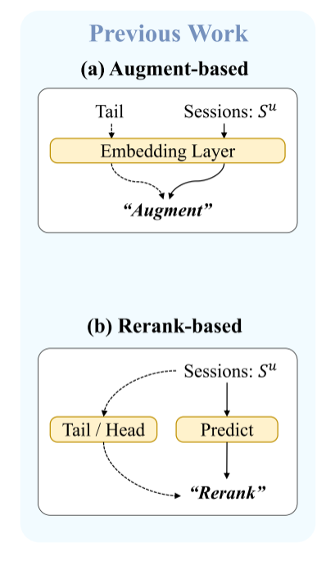
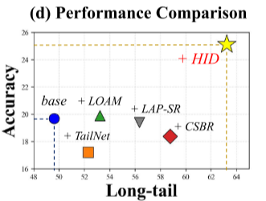
ATAI
Advanced Technique of Artificial Intelligence
ATAI
ChongqingUniversity _{AdvancedTechniqueof}
of Technology Artificial Intelligence
Chongqing University of
Technology
Chongqing University ^{ATAI}
_{of Technology} Advanced Techniqueof
Artificial Intelligence
Chongqing University of Technology
Chongqing University of Technology
Motivation
(1) Indiscriminate Emphasis on Tail Items.
Cause: Blindly promote all tail items -> Introduce session-irrelevant noise.
Result: Severe accuracy degradation (the "seesaw" effect).
(2) Lack of Explicit Long-tail Supervision.
Cause: Rely solely on indirect optimization (cross-entropy).
Result: No explicit signals to concurrently balance long-tail diversity and accuracy.

Slide 3
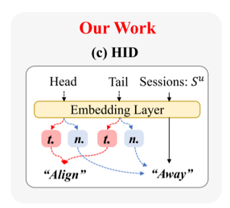
ATAI
Advanced Technique of Artificial Intelligence
ATAI
ChongqingUniversity _{AdvancedTechniqueof}
of Technology Artificial Intelligence
Chongqing University of
Technology
Chongqing University ^{ATAI}
_{of Technology} Advanced Techniqueof
Artificial Intelligence
Chongqing University of Technology
Chongqing University of Technology
Method
Overview of HID: Dual Constraints on Hybrid Intent Space

Slide 4
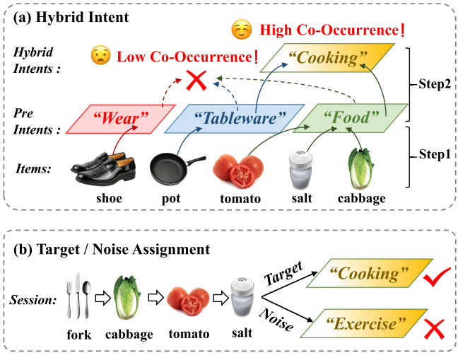
ATAI
Advanced Technique of Artificial Intelligence
ATAI
ChongqingUniversity _{AdvancedTechniqueof}
of Technology Artificial Intelligence
Chongqing University of
Technology
Chongqing University ^{ATAI}
_{of Technology} Advanced Techniqueof
Artificial Intelligence
Chongqing University of Technology
Chongqing University of Technology
Method
Step 1: Preliminary Intent;
Step 2: Spectral Clustering for Hybrid Intent
Target Intent for Positive Signal;
Noise Intent for Negative Signal

Slide 5
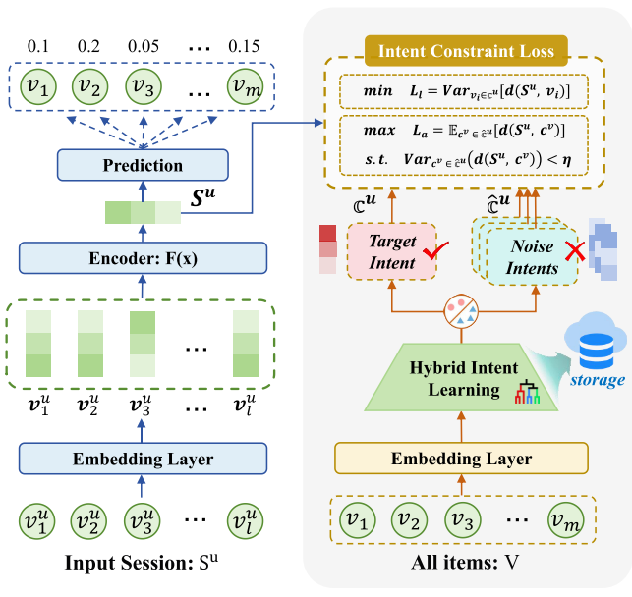
ATAI
Advanced Technique of Artificial Intelligence
ATAI
ChongqingUniversity _{AdvancedTechniqueof}
of Technology Artificial Intelligence
Chongqing University of
Technology
Chongqing University ^{ATAI}
_{of Technology} Advanced Techniqueof
Artificial Intelligence
Chongqing University of Technology
Chongqing University of Technology
Method

Slide 6




ATAI
Advanced Technique of Artificial Intelligence
ATAI
ChongqingUniversity _{AdvancedTechniqueof}
of Technology Artificial Intelligence
Chongqing University of
Technology
Chongqing University ^{ATAI}
_{of Technology} Advanced Techniqueof
Artificial Intelligence
Chongqing University of Technology
Chongqing University of Technology
Method

Slide 7
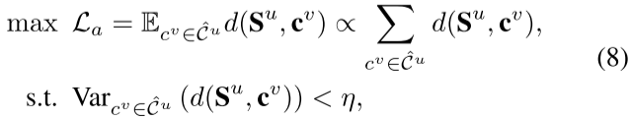
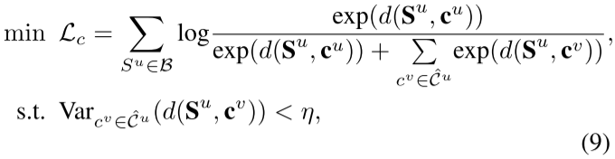

ATAI
Advanced Technique of Artificial Intelligence
ATAI
ChongqingUniversity _{AdvancedTechniqueof}
of Technology Artificial Intelligence
Chongqing University of
Technology
Chongqing University ^{ATAI}
_{of Technology} Advanced Techniqueof
Artificial Intelligence
Chongqing University of Technology
Chongqing University of Technology
Method

Slide 8
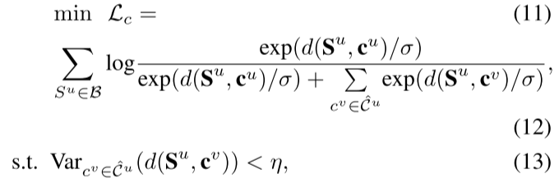


ATAI
Advanced Technique of Artificial Intelligence
ATAI
ChongqingUniversity _{AdvancedTechniqueof}
of Technology Artificial Intelligence
Chongqing University of
Technology
Chongqing University ^{ATAI}
_{of Technology} Advanced Techniqueof
Artificial Intelligence
Chongqing University of Technology
Chongqing University of Technology
Method

Slide 9
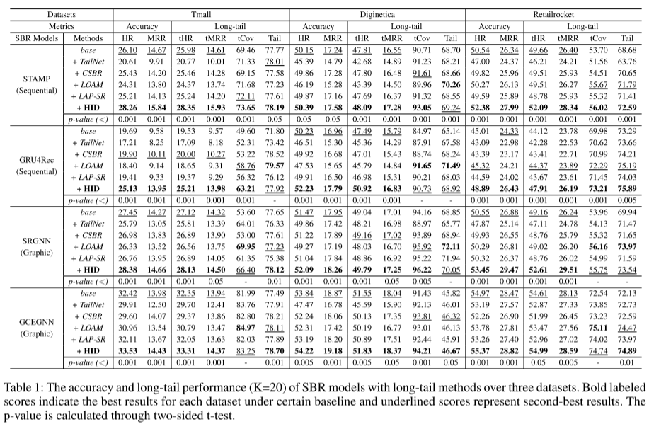
ATAI
Advanced Technique of Artificial Intelligence
ATAI
ChongqingUniversity _{AdvancedTechniqueof}
of Technology Artificial Intelligence
Chongqing University of
Technology
Chongqing University ^{ATAI}
_{of Technology} Advanced Techniqueof
Artificial Intelligence
Chongqing University of Technology
Chongqing University of Technology
Experiments

Slide 10
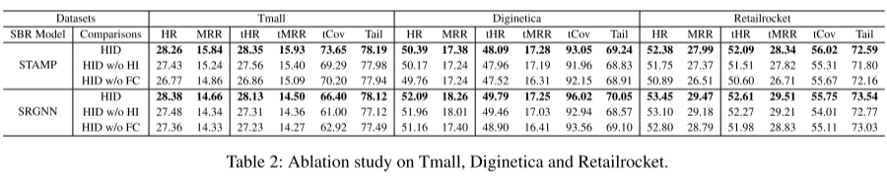
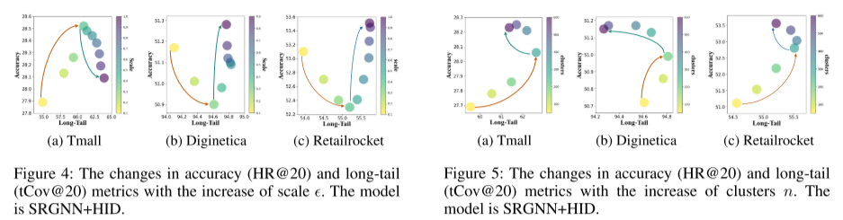
ATAI
Advanced Technique of Artificial Intelligence
ATAI
ChongqingUniversity _{AdvancedTechniqueof}
of Technology Artificial Intelligence
Chongqing University of
Technology
Chongqing University ^{ATAI}
_{of Technology} Advanced Techniqueof
Artificial Intelligence
Chongqing University of Technology
Chongqing University of Technology
Experiments

Slide 11


ATAI
Advanced Technique of Artificial Intelligence
ATAI
ChongqingUniversity _{AdvancedTechniqueof}
of Technology Artificial Intelligence
Chongqing University of
Technology
Chongqing University ^{ATAI}
_{of Technology} Advanced Techniqueof
Artificial Intelligence
Chongqing University of Technology
Chongqing University of Technology
Thanks!

